Slide 1

Exploring Artificial Intelligence: Theory Meets Practice
Presented by: FAHIMAJJAMAN JAINA (ID: 0562310005101045) Course Code: CSE-06133115 (Theory), CSE-06133116 (Lab) Course Taken By: Razorshi Prozzwal Talukder

Slide 2
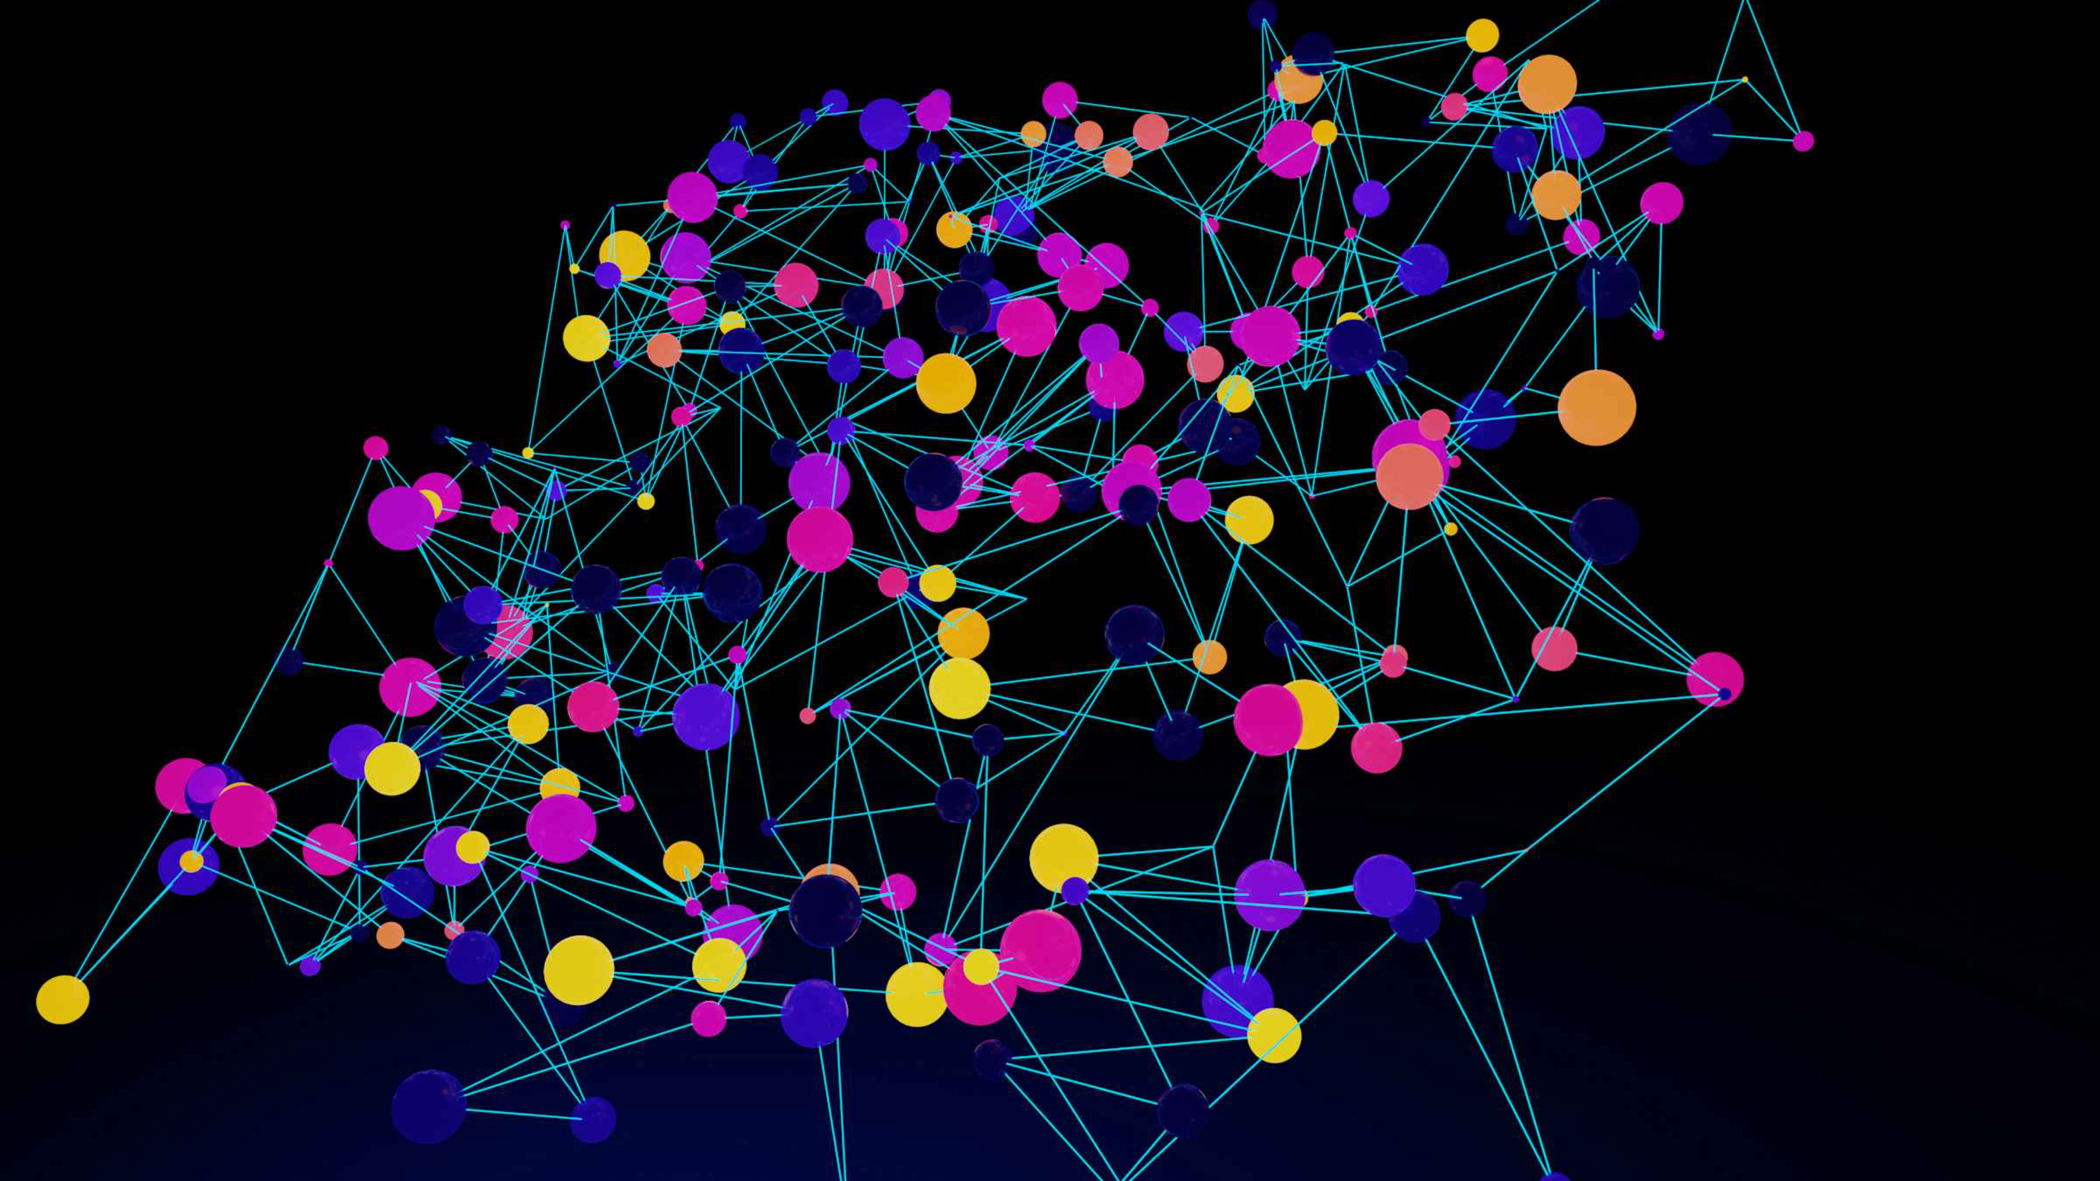



Course Overview: Why AI Matters
To understand fundamental AI principles and implement intelligent systems capable of solving real-world challenges using Python. This course bridges the gap between theoretical knowledge and practical application.
Why Study AI?
To model and simulate intelligent behaviour
To tackle complex, human-centred problems
To innovate across various industries

Slide 3
Theoretical Foundations of AI
Introduction to AI
Search Algorithms
Environments & Agents
BFS, DFS, UCS, IDS
AI vs Human Intelligence
Heuristic & A\* Search
Local Search
Adversarial Search
Hill Climbing
Minimax Algorithm
Simulated Annealing
Alpha-Beta Pruning
Genetic Algorithms
CSP & Reasoning
Learning & Planning
Backtracking
Reinforcement Learning
Bayesian Inference
Bellman Equation
Policy Iteration

Slide 4
Hands-on Lab Activities
Search Algorithms
1
Implemented Breadth-First Search (BFS), Depth-First Search (DFS), Uniform Cost Search (UCS), and A* search in Python for pathfinding and state-space exploration.
Heuristics & Local Search
2
Solved complex optimization problems using local search techniques like simulated annealing and genetic algorithms.
Adversarial Games
3
Developed AI for Tic-Tac-Toe and Chess, incorporating Minimax and Alpha-Beta Pruning for optimal decision-making.
Constraint Satisfaction Problems
4
Addressed CSPs such as Map Coloring and the Two + Two = Four puzzle, applying backtracking search.
Reinforcement Learning
5
Implemented core Reinforcement Learning algorithms including Value Iteration and Policy Iteration for decision-making in dynamic environments.

Slide 5
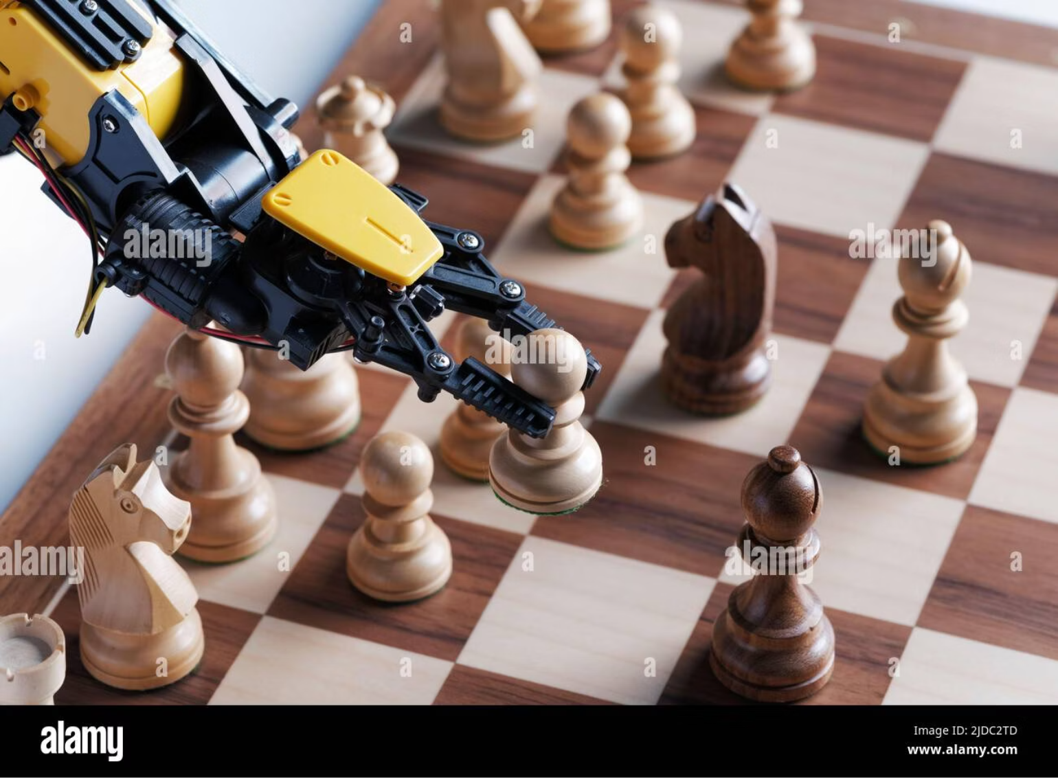
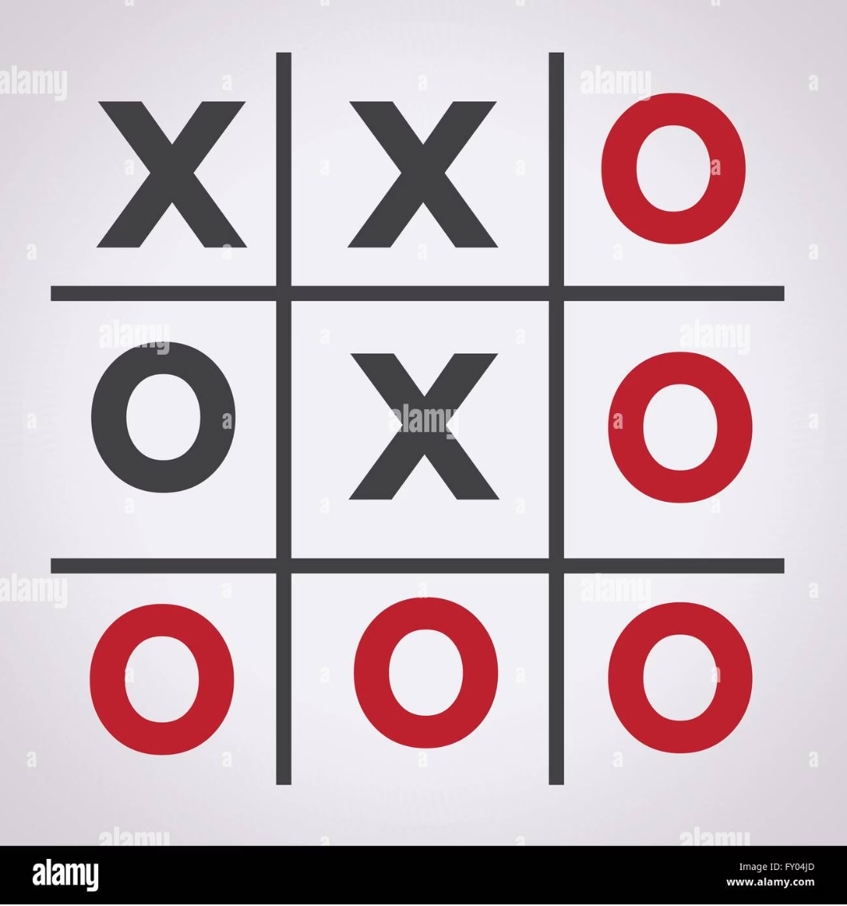
AI in Action: Game Projects
Chess AI Engine (Prototype)
Tic-Tac-Toe AI
Utilises Minimax with Alpha-Beta Pruning.
Implemented using the Minimax Algorithm.
Efficiently evaluates and selects optimal moves.
Ensures the AI makes optimal, unbeatable moves.
A foundation for advanced strategic gameplay.
Demonstrates foundational game theory concepts.

Slide 6




Tools and Acquired Skills
Python Proficiency
Algorithm Design
Mastered Python for AI algorithm development and data manipulation.
Developed robust skills in designing and implementing complex algorithms.
Debugging Expertise
Problem Solving
Honed abilities to diagnose and resolve issues efficiently in AI systems.
Applied analytical thinking to dissect and solve intricate AI challenges.

Slide 7
Comprehensive Learning Outcomes
From Theory
From Lab
Compare AI with traditional computational methods.
Implement diverse AI algorithms in Python.
Apply various search & reasoning techniques.
Analyse algorithm performance in various scenarios.
Understand reinforcement learning principles.
Apply theoretical knowledge to real-world problems.
Improve communication through academic presentations.
Design and report on practical AI projects.

Slide 8



Personal Learning Reflection
Theory: Conceptual Understanding
Lab: Practical Application
Holistic Understanding
I now grasp how intelligent systems think, search for solutions, and continuously learn and adapt.
The theoretical component provided a solid foundation, illuminating the 'what' and 'why' behind AI.
Lab sessions transformed abstract concepts into tangible skills, bridging theory with practical implementation.

Slide 9
Future Goals in AI
My journey in Artificial Intelligence is just beginning. I aim to:
Advanced Topics
1
Delve deeper into Deep Learning, Natural Language Processing, and Computer Vision.
Real-World Projects
2
Engage in projects that solve practical problems, strengthening applied experience.
Community Contribution
3
Actively contribute to open-source AI communities and GitHub repositories.
Continuous Learning
4
Pursue certifications and advanced courses in AI and Data Science.
Portfolio Development
5
Build a robust portfolio of intelligent applications and research solutions.
Career Path
6
Seek internships/roles in Machine Learning, AI Engineering, or Data Analytics.

Slide 10

Thank You
Your attention and engagement are greatly appreciated.

